Slide 1

History at WIS – Year 8

Slide 2
Expectations of books, home learning and lessons?

Slide 3

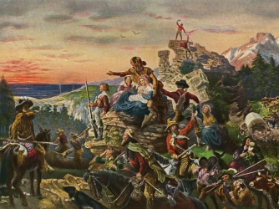
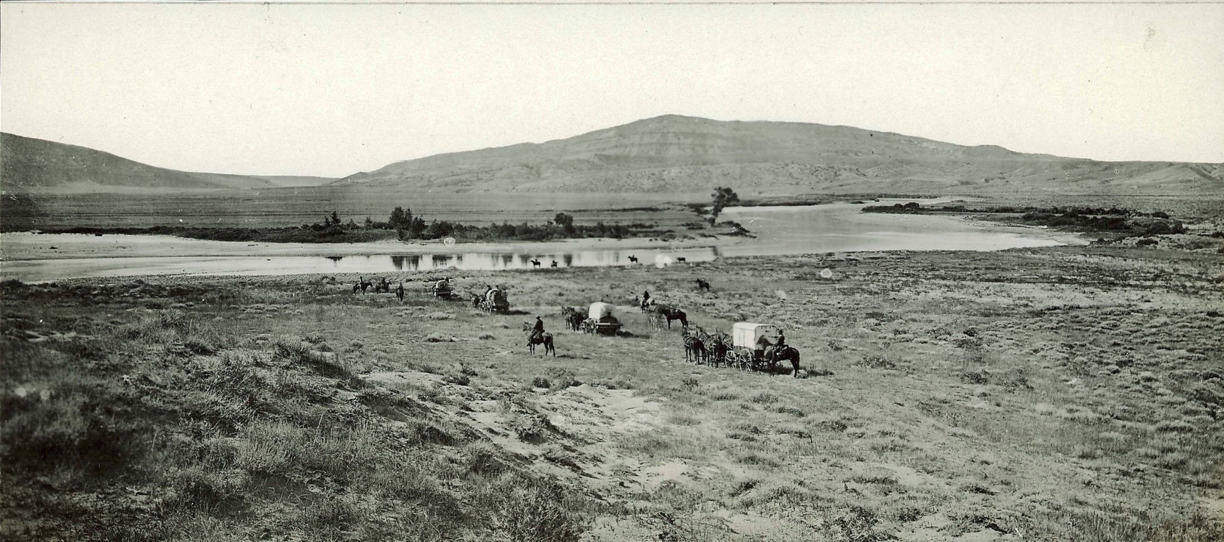
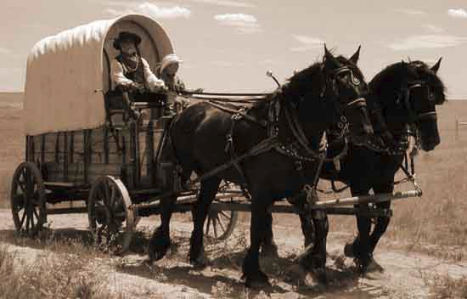
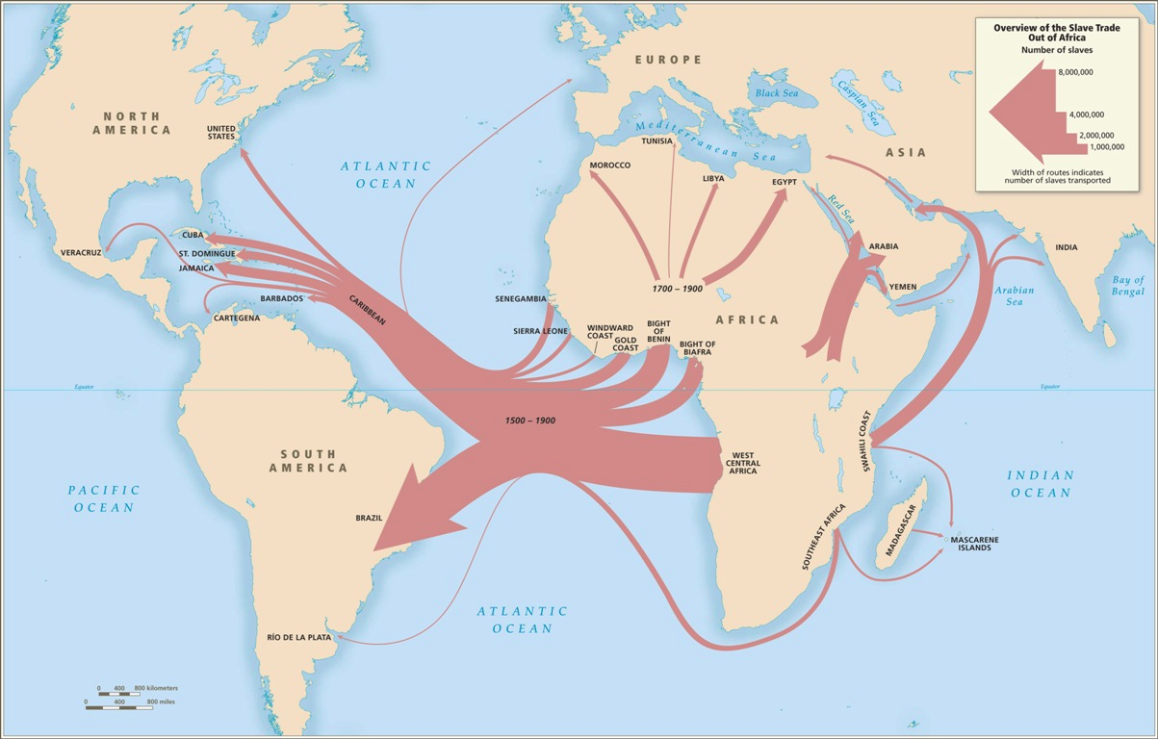

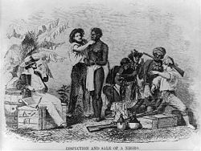
What will I be finding out about?
Migration and Discovery

Slide 4

Native Americans
Learning Objective:
Understand who native Americans were.
Assess what their lifestyles were like
When was the USA ‘discovered’ by Europeans?
What is meant by the word native?
Who first found the USA?
How many native people lived in the USA before it was ‘discovered’?
Pre knowledge test – what do we know already?
Where did they think they had found?
Where did these people possibly come from?

Slide 6
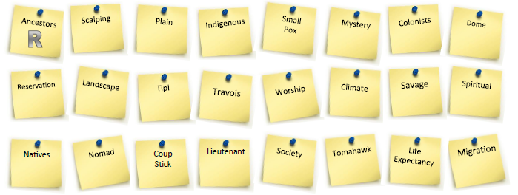
Keywords bingo:
Draw up a 2*3 grid and add 6 of the keywords.
If you hear the correct definition then cross off your word.
First to get all 6 wins…something!

Slide 7
The Native Tribes of America
Read through the brief summary of four major tribes on the next two slides then answer these questions:
If I had to belong to one tribe it would be…
This is because…
I definitely would not want to be a member of…
Because…
Extension:
What do you think the first Europeans thought of these tribes when they first met them?

Slide 8
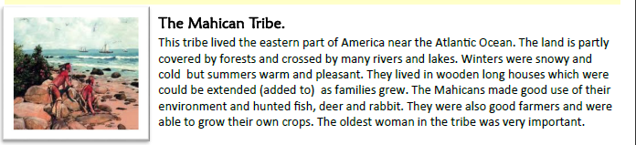
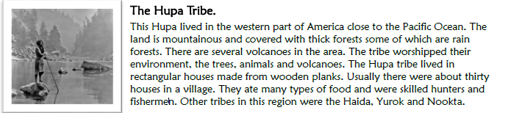

Slide 9
