Slide 1
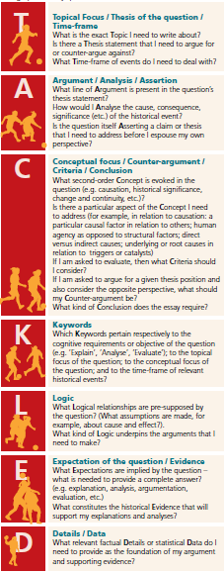
QUESTION: 10. To what extent was Primo de Rivera responsible for his own downfall?
Topic:
Time Frame:
Argument:
Analyse:
Concepts:
Criteria:
Conclusion:
Keywords in question:
Keywords for Timeframe:
Expectations:
Details / data:

Slide 2
QUESTION: 10. To what extent was Primo de Rivera responsible for his own downfall?
Possible Outline (by ‘argument’):
Details I would use to support:
Intro: Define and key terms, outline method and scope – leading to key argument as per conclusion.
A –
B-
C –
D -
Conclusion?

