Slide 1
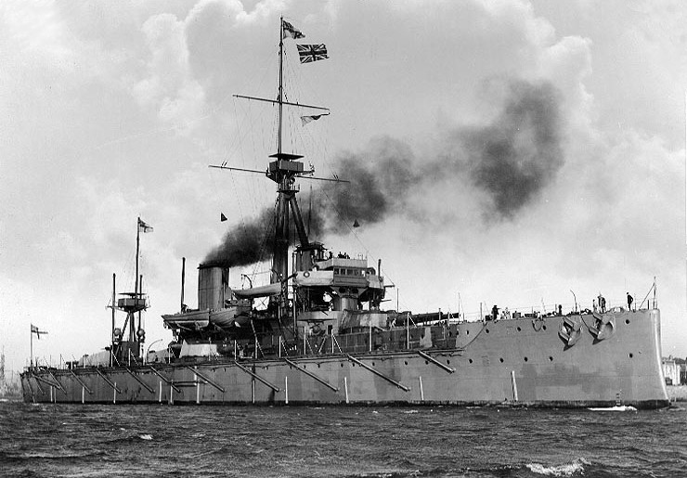
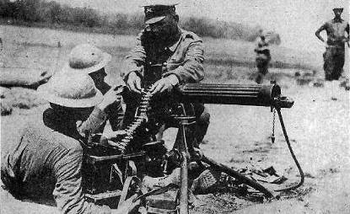
How did Military Rivalry contribute to the outbreak of war?
L/O – To consider how militarism led to increasing tensions between the two alliances

Slide 2
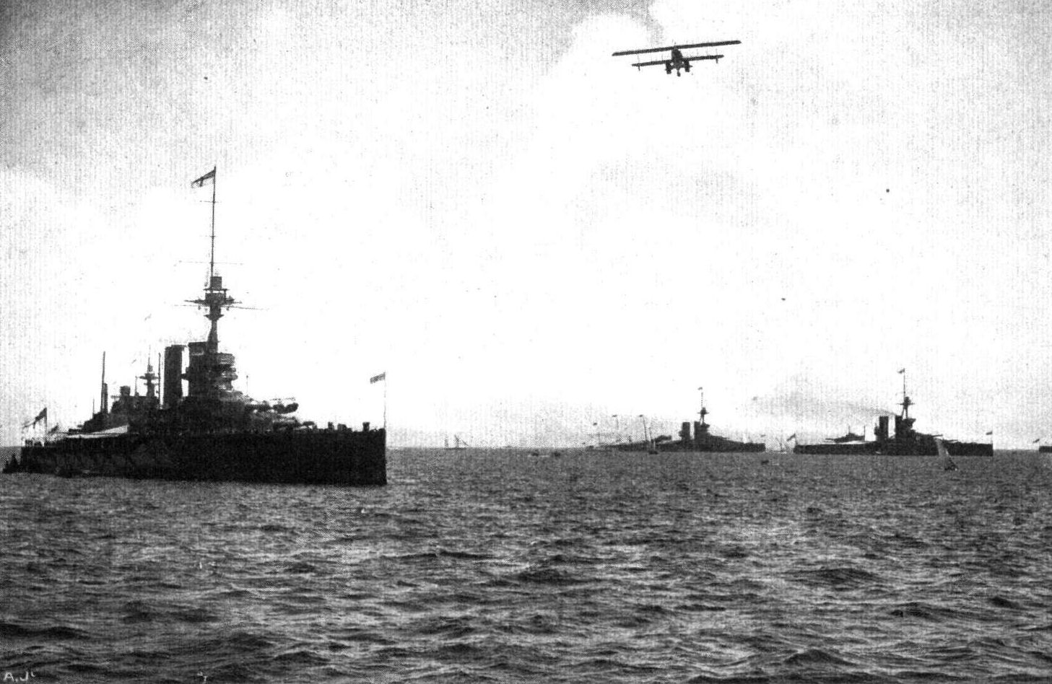

Slide 3
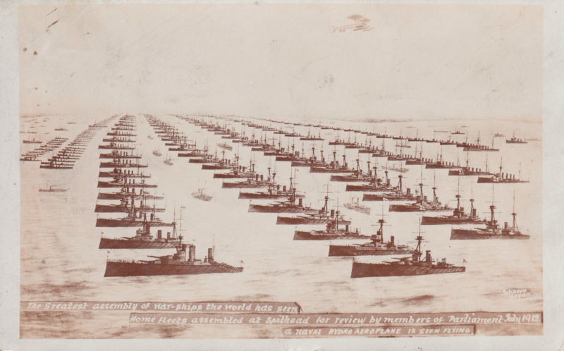

Slide 4
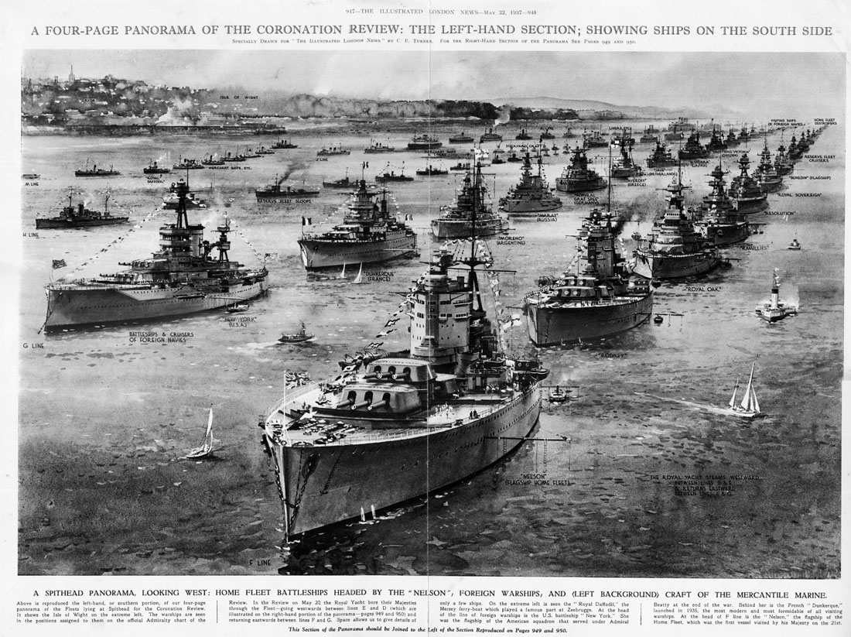

Slide 5
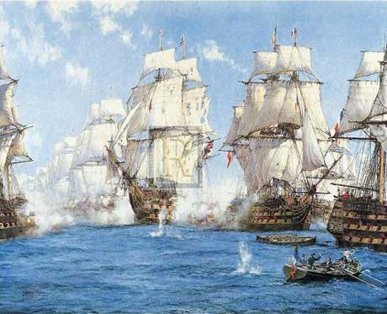
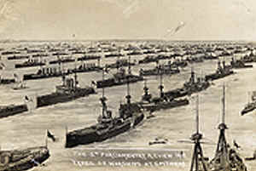
Britannia rules the waves
Britain had defeated the French at the Battle of Trafalgar in 1805 and since then had controlled the seas with the most powerful navy in the world.
As long as Britain had the world’s strongest navy, it could make sure that none of the other Great Powers would try to seize parts of its empire or invade Britain itself.
But what if another country wanted to challenge Britain’s naval superiority?

Slide 6
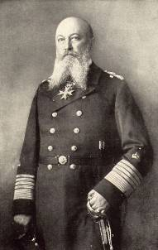
German Naval Building Programme
In 1898, Kaiser Wilhelm announced that Germany was going to build 41 battleships and 61 cruisers.
This was part of a plan to make sure that Germany could defend itself and protect its growing overseas trade.
“In my view, Germany will, in the coming century, rapidly drop from her position as a great power unless we begin to develop our maritime interests energetically, systematically and without delay.”
^{Admiral Tirpitz, 1895}

Slide 7
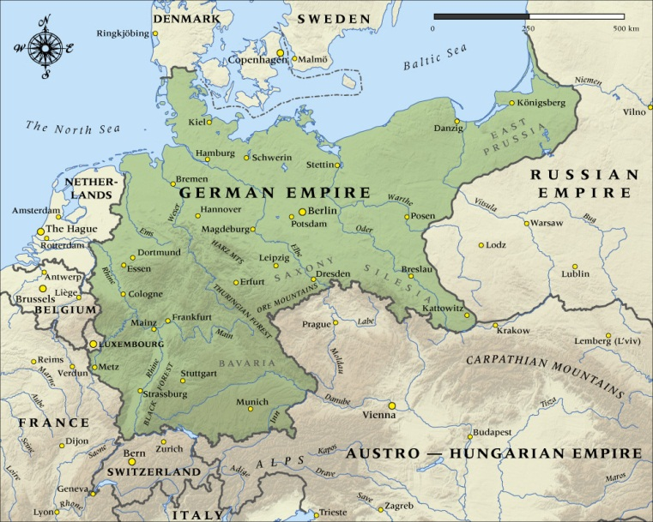
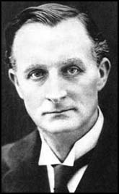
Importance of the Navy
Britain saw the German naval building programme as part of a deliberate policy to challenge British naval supremacy.
After all, Germany was in central Europe and needed a large army to protect its borders, why did it need a navy?
‘There is no comparison between the importance of the German navy to Germany and the importance of our navy to us…it is not a matter of life and death to them as it is to us.’
(British Foreign Secretary, Sir Edward Grey, 1909)

Slide 8
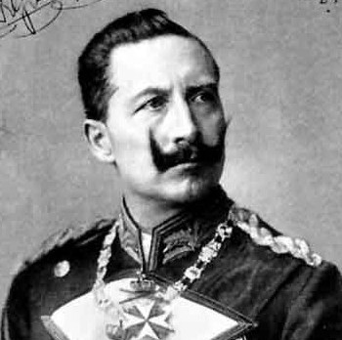
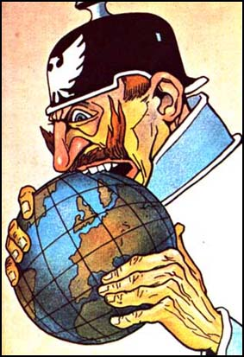
Importance of the Navy
Was Wilhelm deliberately trying to challenge British naval supremacy? Or was he genuinely building a large navy to protect Germany’s trade and small empire?
Another reason for the Kaiser’s actions was to frighten the British into reaching an agreement with Germany instead of France.
1. ‘The Kaiser built a great navy only to challenge Britain.’ Do you agree? Give reasons for your answer, showing you have thought about more than one point of view.

Slide 9
An ‘arms race’ develops
Arms Race = when two nations compete to develop the best military technology or the largest armed forces.
The ‘race’ is driven by fear that the other country will establish military superiority, and therefore become dominant.

Slide 10
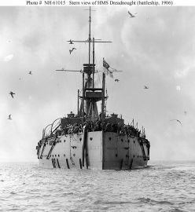
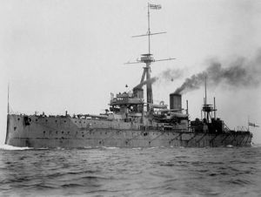
HMS Dreadnought
Britain saw Germany’s shipbuilding programme as a threat. Talks were held to try to limit the size of the British and German navies, but they broke down.
Then in 1906, the game changed. Britain launched the first of a new type of battleship, HMS Dreadnought. This worried the Germans.
The ship was so powerful that all previous battleships were immediately out of date and became known as ‘funf minuten’ (five minute ships). All ships of this new type became known as ‘Dreadnoughts’.

Slide 11
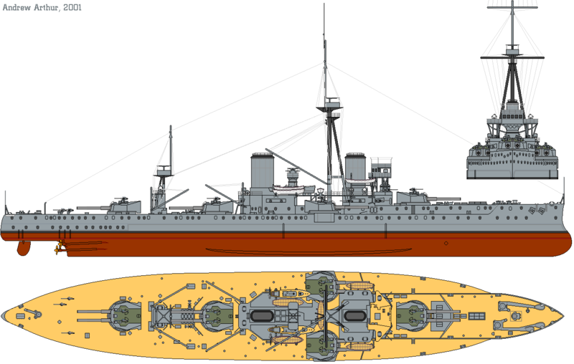

Slide 12
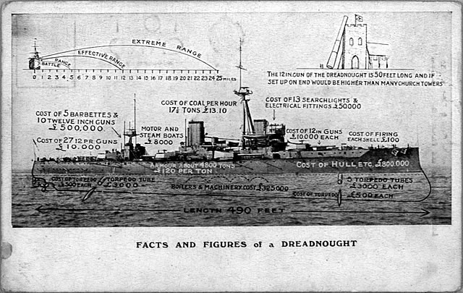

Slide 13
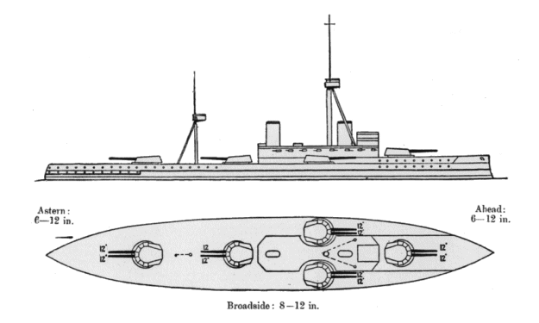

Slide 14
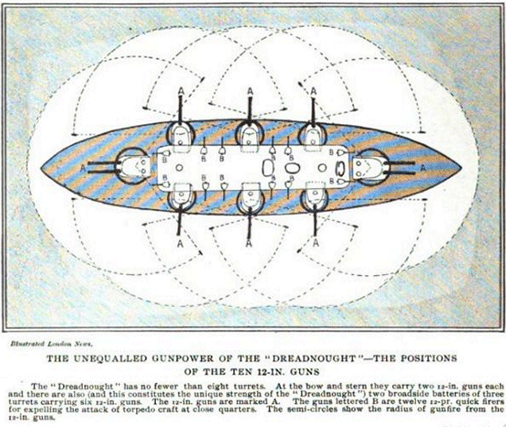

Slide 15
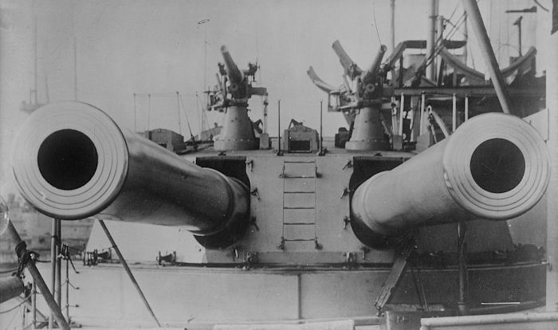
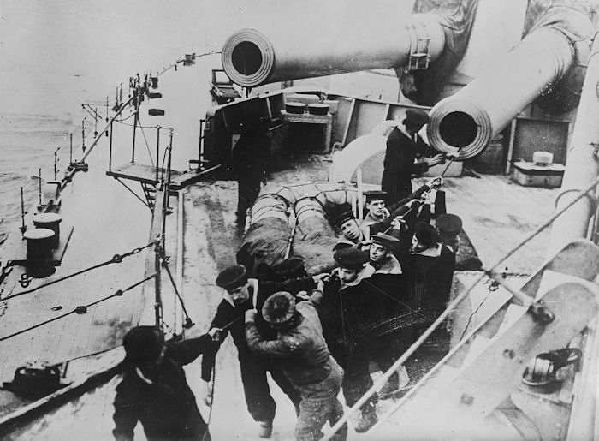
HMS Dreadnought
The ship had thicker armour, more powerful guns with a bigger range and a faster speed.
HMS Dreadnought: 17,900 tons; 526 feet in length; ten 12 inch guns, eighteen 4 inch guns, five torpedo tubes; maximum belt armour 11 inches; top speed 21.6 knots.
What mattered now was not how many ships the navy had, but how many dreadnoughts it had.
So if Germany could build more of these ships than Britain did, it would have a more powerful navy.

Slide 16
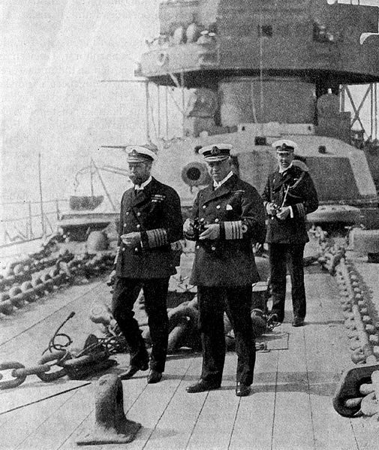
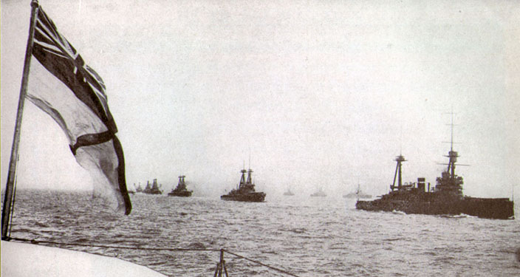
The Two-Power Standard
From 1889 Britain had followed a policy of ensuring that its navy was at least as big as its two nearest rivals combined. This policy was known as the “two power standard.”
As Germany built Dreadnought-style ships to compete with Britain, Britain felt obliged to build as many, or more, ships to stay ahead.
This created a naval arms race, a race to build the most warships!

Slide 17
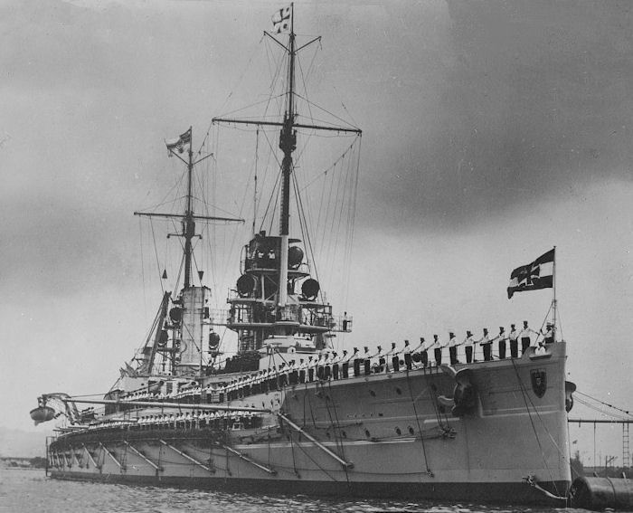
Kaiser, 1911

Slide 18
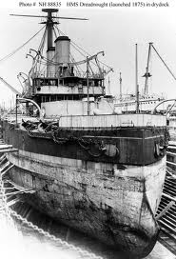
The Naval Race
With the launch in 1906 of HMS Dreadnought, an ‘arms race’ broke out between Britain and Germany as both tried to build more Dreadnoughts.
Between 1906-1907 Britain built five and it wasn’t until 1908 that Germany built its first.
Then in 1908, Germany built four compared to Britain’s two!

Slide 19
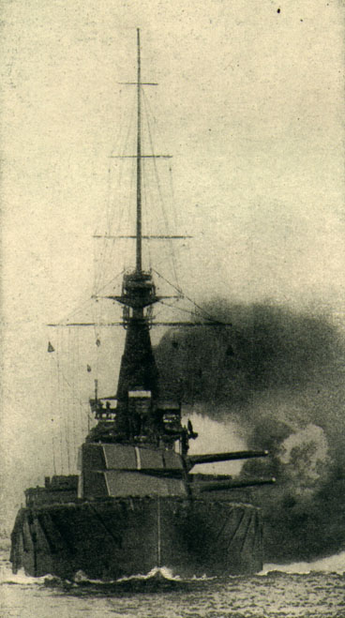
The Naval Race
Britain considered building either two or four new ships in the years 1910-1911, but the British public began demanding eight.
There were even times in music halls when the audience burst into a chorus of ‘We want eight and we won’t wait.’ Public opinion turned increasingly anti-German.
So eight ships were built 1910-1911. In total, between 1906-1914, Britain built 29 compared to Germany’s 17.

Slide 20
The Naval Race 1906-1914
Dreadnoughts | Great Britain | Germany
1906 | 1 | 0
1907 | 3 | 0
1908 | 2 | 4
1909 | 2 | 3
1910 | 3 | 1
1911 | 5 | 3
1912 | 3 | 2
1913 | 7 | 3
1914 | 3 | 1
Total | 29 | 17

Slide 21
The Naval Arms Race

Slide 22
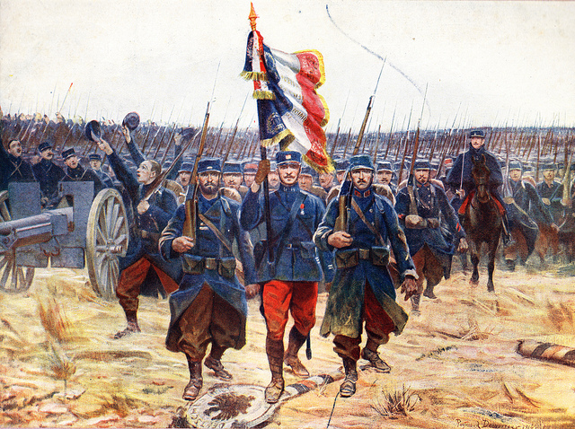
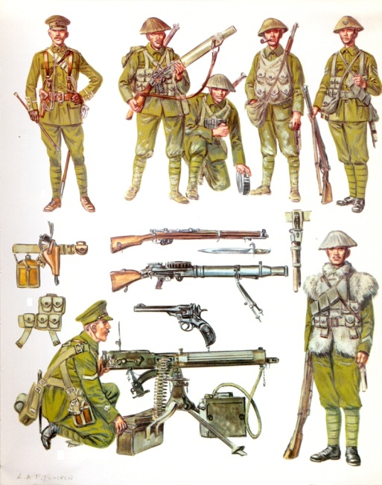
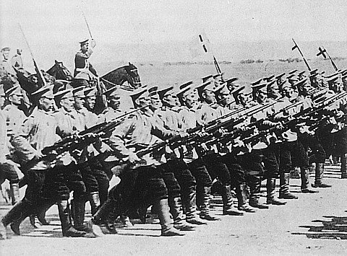
The build-up of armies
Britain felt secure from having a strong navy whereas European powers gained security from having a large army powerful enough to prevent an attack from another country.
The Great Powers in Europe concentrated on building up their armed forces and ensuring their soldiers were well trained. All the Great Powers except Britain introduced conscription.
In France, soldiers had to serve for 3 years and in Russia, for 3 ½ years.

Slide 23
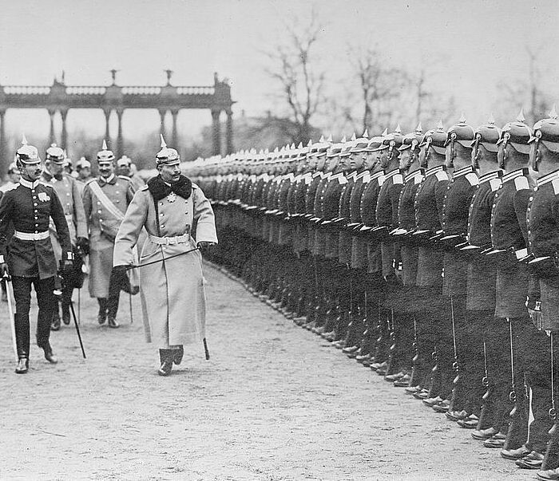

Slide 24
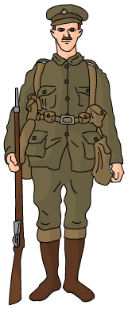
The build-up of armies
By 1914, the armies of the Great Powers numbered more than 4 million men, with another 2 million reservists waiting to be called up.
Such militarism could only lead to increased tensions in Europe, making war more likely.
Country
Army size in 1914
Britain
430,000
On paper, which alliance had more soldiers?
France
970,000
Russia
1,500,000
Germany
760,000
Austria-Hungary
480,000

Slide 25
Size of the armies in Europe 1900-1914 (in millions)
2. Which country’s army increased the least during this period? Suggest reasons for this.
3. Which country had the greatest percentage increase in its army between 1900 & 1914?

Slide 26
Britain vs. Germany

Slide 27
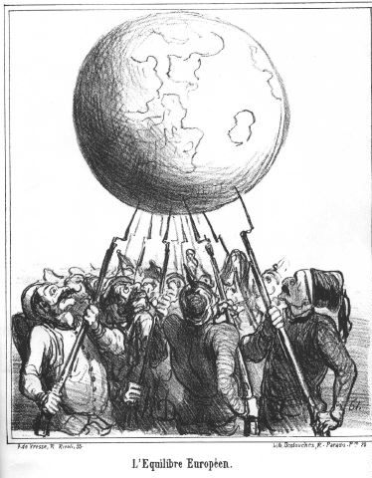
The ‘balance of power’
Each of the Great Powers became involved in an arms race to make sure they had enough forces to win a war. But this does not mean they intended to fight.
Each country knew that it was important to make sure that its forces balanced those of any potential enemy, so that enemy would be less likely to attack.
In this sense, building up armed forces was actually a way of preventing war!

Slide 28
QUESTIONS
You are preparing for a debate but don’t know which side you will be speaking for! The debate is ‘Did the Kaiser build a great navy just to threaten Britain?’ Make some notes for each side of the argument. Which side would you prefer to speak for? Why?
‘We want eight and we won’t wait’ is a great slogan. Can you think of any other good slogans for the events described on these pages?
Consider the statement, ‘building up armed forces was actually a way of preventing war’. That sounds like nonsense. Explain how making your armed forces stronger could stop war.

