Slide 1
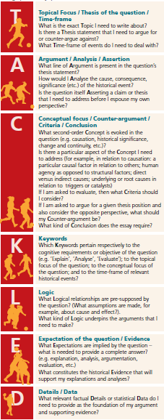
Topic:
Time Frame:
QUESTION: “The policies and situation of the Weimar Republic by 1929 meant that it was in a strong position had it not been for subsequent external factors”. To what extent do you agree?
Argument:
Analyse:
Concepts:
Criteria:
Conclusion:
Keywords in question:
Keywords for Timeframe:
Expectations:
Details / data:

Slide 2
QUESTION: Were the policies and the development in Germany, by early 1929, sufficient for the survival of the Weimar Republic?
Possible Outline (by ‘argument’):
Details I would use to support:
Intro: Define and key terms, outline method and scope – leading to key argument as per conclusion.
A –
B-
C –
D -
Conclusion?

