Slide 1
The History Internal Assessment
Key Questions:
What are the key assessment elements?
How long should it be?
What is an appropriate topic?
How will it be marked?
What is the role of the teacher?

Slide 2
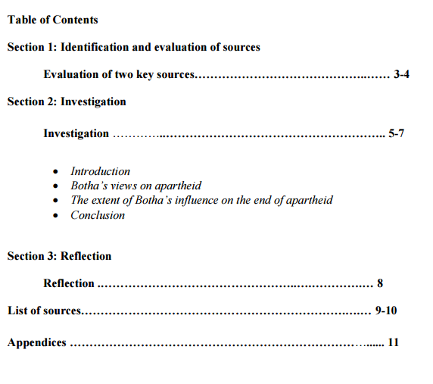
What is the Internal Assessment?
Key features:
A genuine historical question.
It must be specific and debatable (alternate view points/explanations)
Researched independently, written to a 2,200 word limit
Fully cited – MLA 7
Primary and secondary sources should be used. The overwhelming number of secondary sources should be historians
Two sources must be evaluated for usefulness and reliability.

Slide 3
What about my question?
Requirements:
Examples:
Originated by the student
Must be focused and arguable
Cannot deal with subject matter within the last 10 years
Must be within the subject definitions (e.g. film / sports can go very wrong)
Free choice of time period / topic
A historical topic or theme using a variety of sources
A historical topic based on fieldwork, for example, a museum or archaeological site
A local history study

Slide 4
Formulating a good question:
How systematic were the deportations of the Jewish population of Dusseldorf to Minsk between 1941 and 1942?
How significant were economic problems as a cause of the Bamberg Witch Trials (1623–1633)?
What were the most important reasons for the failure of Operation Market Garden?
To what extent was weak leadership responsible for the collapse of the Egyptian Old Kingdom in 2125 BC?

Slide 5
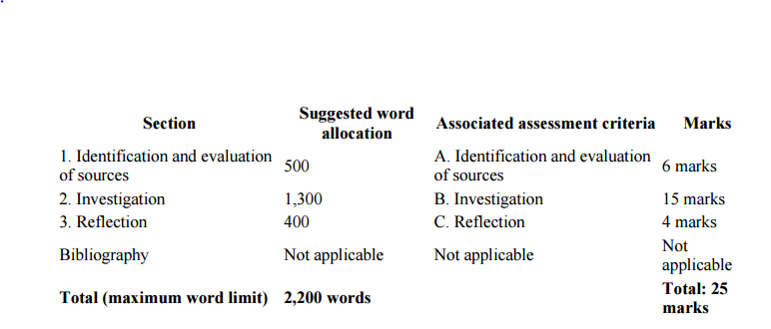
How will it be marked?
See the document for full criteria.

Slide 6
What is the role of the teacher?
1. Discuss with students the nature of the internal assessment task, and ensure that they are familiar with the assessment criteria.
2. Discuss with students the different types of investigation that they could undertake.
3. Discuss with students the importance of academic honesty before they undertake their research, and emphasize the importance of using a single, standard system of referencing. Dedicate about 20 hours of class time to the internal assessment task.
4. Help students to create an individual timetable for the different stages of the investigation; for example: choosing the topic, finishing the first draft, and the due date for the final version.
5. Give students guidance on what constitutes a manageable task. Many internal assessment responses struggle to gain good marks because the question that students have chosen are far too broad for them to address effectively. Give students guidance on selecting appropriate sources.
6. Give students feedback on a first draft of their internal assessment (this may be done in sections if preferred)
.

Slide 7
Timeline
Final deadline will be the 22nd April.
Extensions are not possible in ordinary circumstances.
You will have around 20 in class lessons and homeworks to complete your IA.
This will include your HL lesson so that you can get a second teacher’s perspective.
Your time allocation will begin in the week commencing 29th Feb
This will likely include a visit to the library

