Slide 1
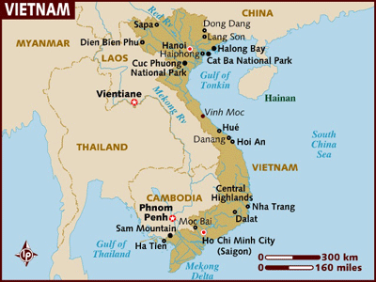
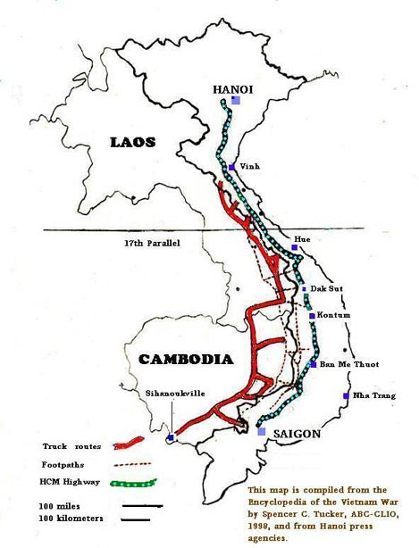
THE BEGINNINGS OF THE VIETNAM WAR
LO - to understand the origins of the Vietnam conflict

Slide 2
Find definitions for these 10 key terms
Communism
Viet Minh
Guerilla tactics
Geneva Agreement
Ho Chi Minh
Ngo Dinh Diem
NLF
Viet Cong
ARVN
Domino Theory
Communism – A classless society where everything is equally owned and controlled.

Slide 3
The origins of the conflict
Since the late 19th C Vietnam had been ruled by France – known as Indochina.
During WW2 Japan took control of the main resources of Vietnam (Coal, Rice, Rubber).
At this time a strong Anti-Japanese movement emerged – called the Viet Minh; under the leadership of Communist Ho Chi Minh (ex teacher).
Ho was a great individual – inspired people to fight
Independent Vietnam declared 2nd September 1945

Slide 4
In 1945 the Viet Minh entered the city of Hanoi and declared Vietnam independent.
The French had other ideas = fight
Ho had not fought the Japanese to give power back to France.
1946 = war.
By 1949 Communists had taken over China - now the US saw the Viet Minh as the puppets of Mao Tse Tung (China). They feared a Communist plan to dominate all of south east Asia.
US poured supported the French with $3 billion of financial aid.

Slide 5
The war dragged from 1946 – 54. The French generally controlled the towns. The Viet Minh, the countryside.
The Viet Minh guerilla tactics made them impossible to beat- tied up troops in a hit and run raid -90,000 casualties.
1954 – French were defeated at a place called Dien Bien Phu. (first time a small Asian state had defeated a European state).

Slide 6
1954 Geneva Agreement
Gave Vietnam independence
Split North (Communist) & south (democratic)
Demilitarized zone between the two
North – led by Ho Chi Minh
South – Ngo Dinh Diem

Slide 7
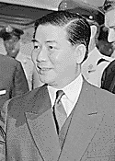
Ngo Dinh Diem
Diem had the support of the USA – he would stop the spread of Communism
He was rich & Catholic – most of the South was poor and Buddhist.
USA grew to hate him

Slide 8
HO CHI MINH
Did not accept the division of Vietnam
Set up the National Liberation Front (NLF) in the South
Diem called them “Vietnamese Commies” (Vietcong for short)
ARVN (Army of the Republic of ((South))Vietnam)was unable to defeat them

Slide 9
Why did US get involved?
President Lyndon B Johnson believed in the Domino Theory
Idea was– if Vietnam fell, then Laos, Cambodia, Thailand, Burma – even India might fall.
By 1964 Johnson was looking for an excuse to become more involved

